Slide 1

Voting DApp
SC6113
Gao Han – G2406016G
Huang Jiajun – G2403109D
Huang Ziling – G2404841D
Yao Fanhui – G2403762C
Yap Bee Lan – G2406184A
Zhan Chunchao – G2402954L

Slide 2
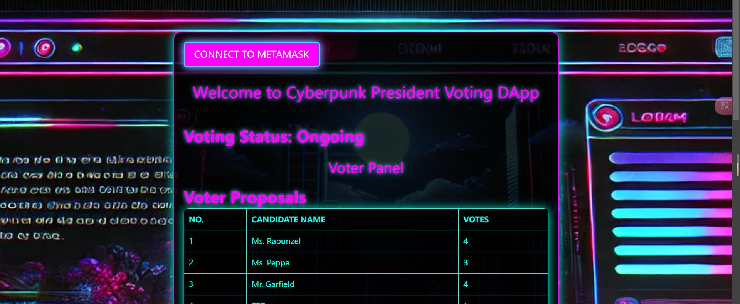
Background
With the rapid development of blockchain technology, decentralized applications (dApps) have been widely applied in many fields, especially in governance systems. Traditional voting systems typically rely on centralized institutions for management and supervision, which suffer from issues such as data tampering, lack of transparency, and high management costs. Blockchain, with its decentralized and immutable characteristics, can provide higher transparency, security, and trust for voting systems.

Slide 3
Project Proposal
This voting system is based on smart contract technology. It aims to provide an efficient, transparent, and secure solution for decentralized governance, allowing users to make decisions on proposals through on-chain voting. The system not only supports the creation and voting of proposals but also dynamically displays all available proposals, updates voting results in real-time, and allows for the settlement of proposals. By introducing a decentralized governance model, the system hopes to address the trust and efficiency issues present in traditional voting systems.

Slide 4
Main function
The system is primarily targeted at decentralized autonomous organizations (DAOs) and other scenarios that require on-chain voting. Users can register as voters and cast their votes for or against proposals. Voting results are recorded and transparently displayed on the blockchain to ensure fairness. The system also supports users in re-registering and participating in multiple voting processes, greatly enhancing user engagement and interactivity.

Slide 5
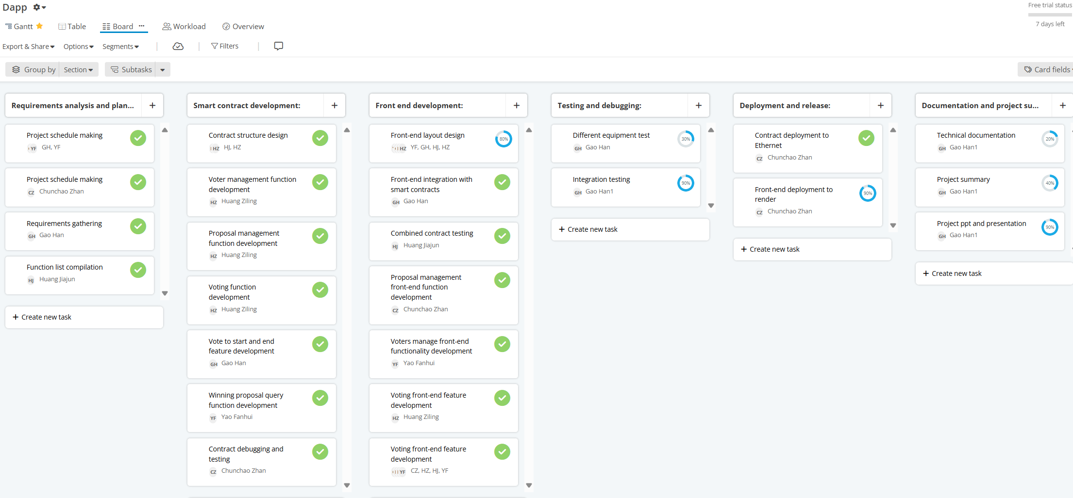
Development Phases

Slide 6
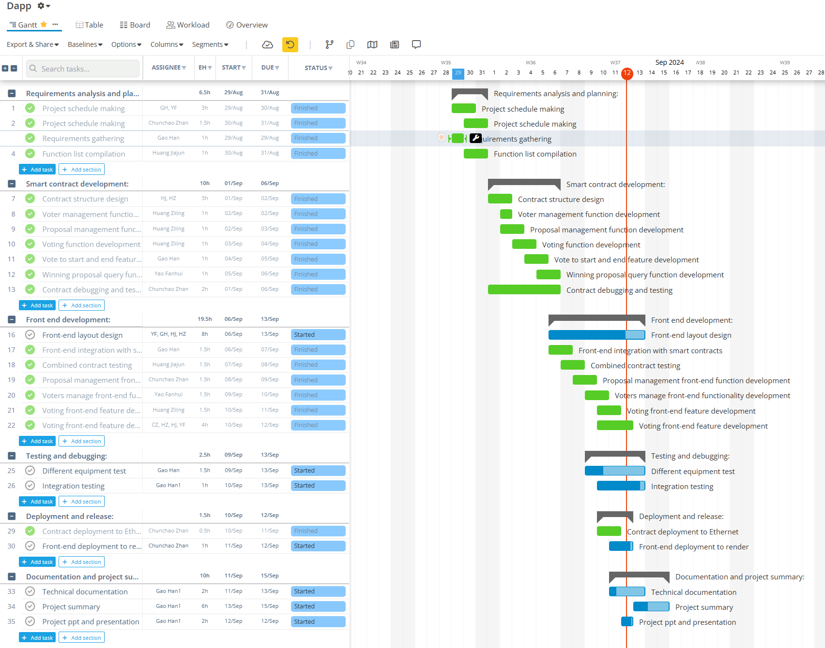

Slide 7
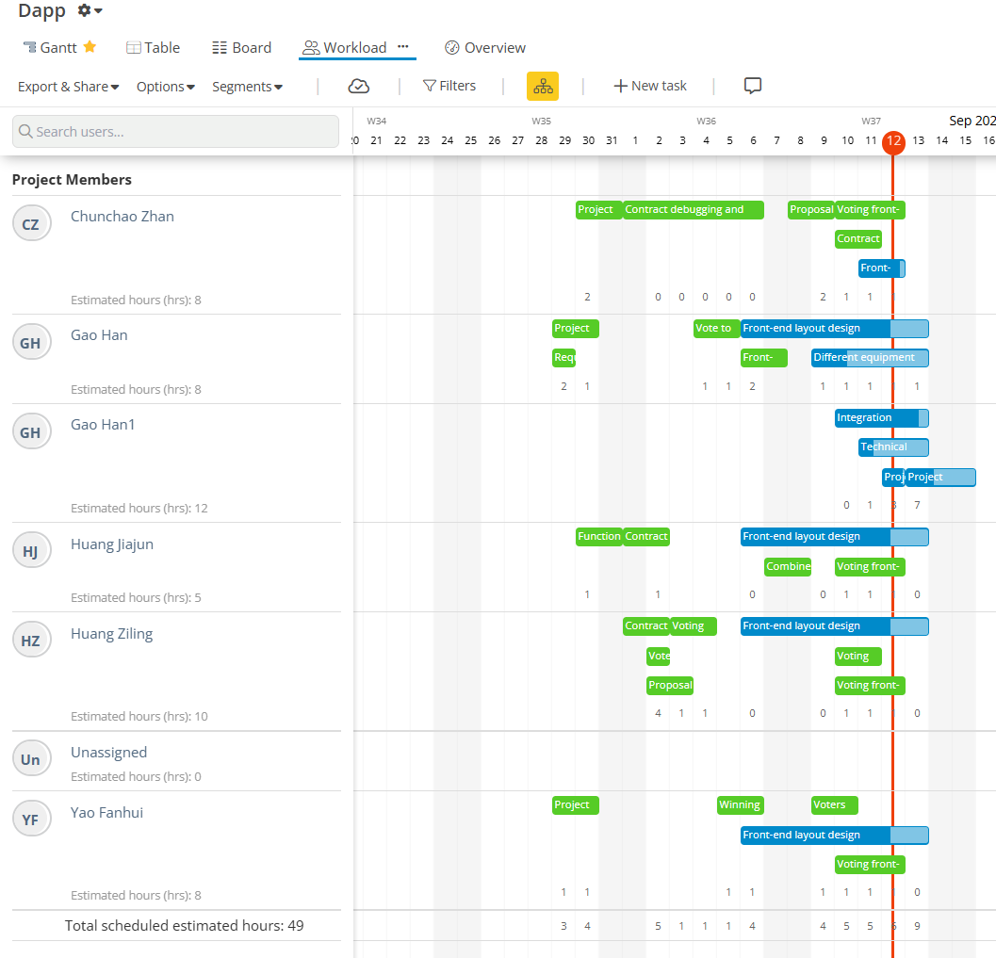
Yap Bee Lan

Slide 8
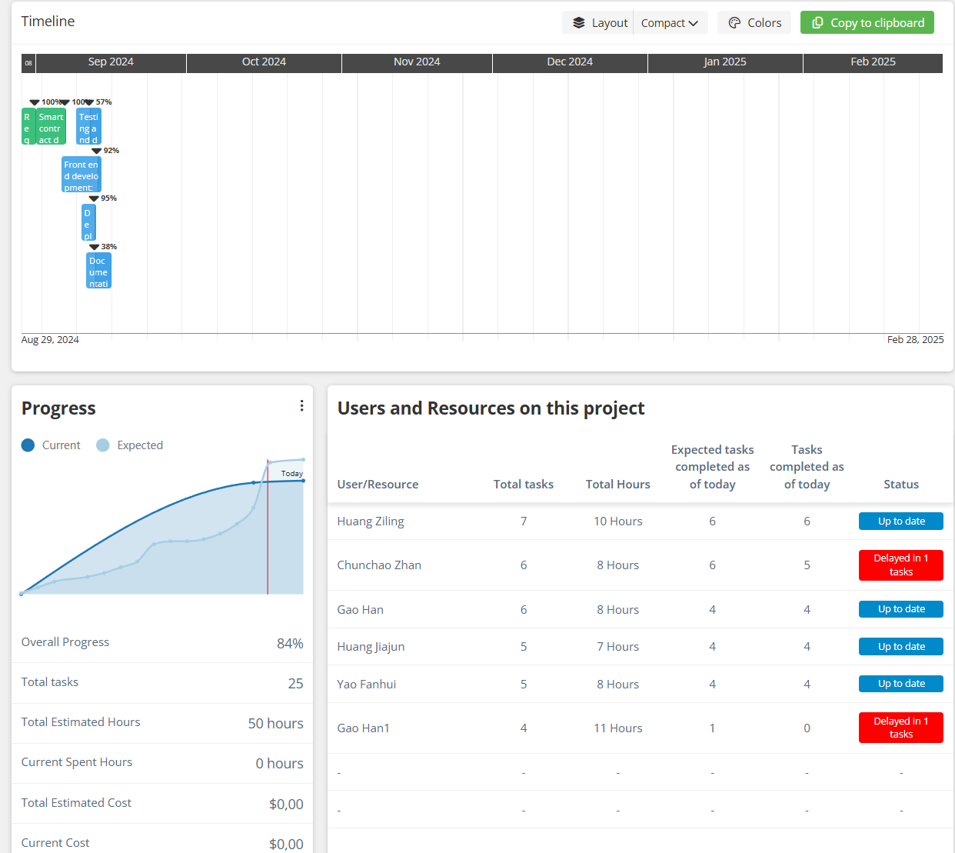
Yap Bee Lan

Slide 9
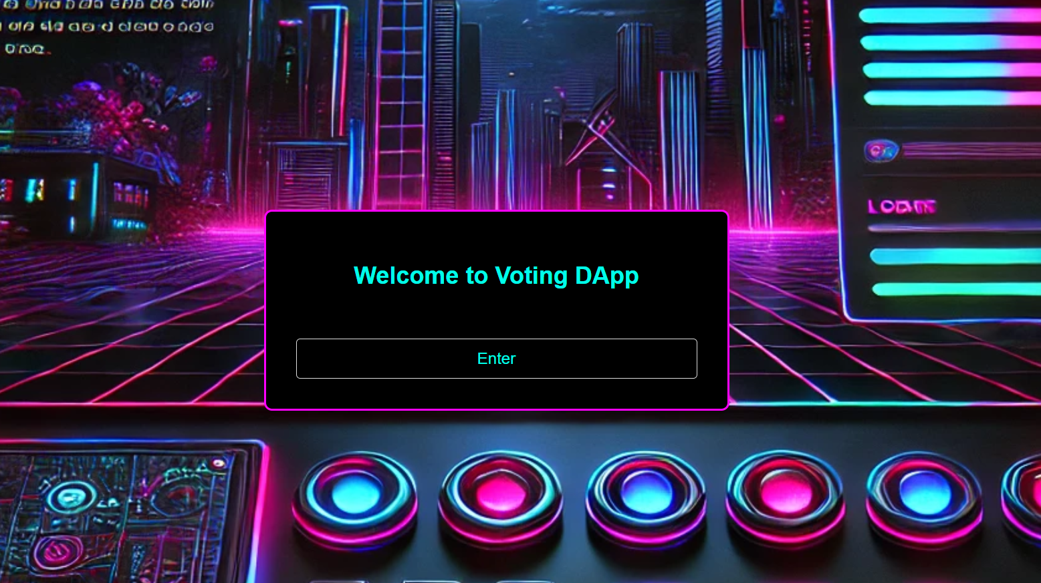
Start
NO.1

Slide 10
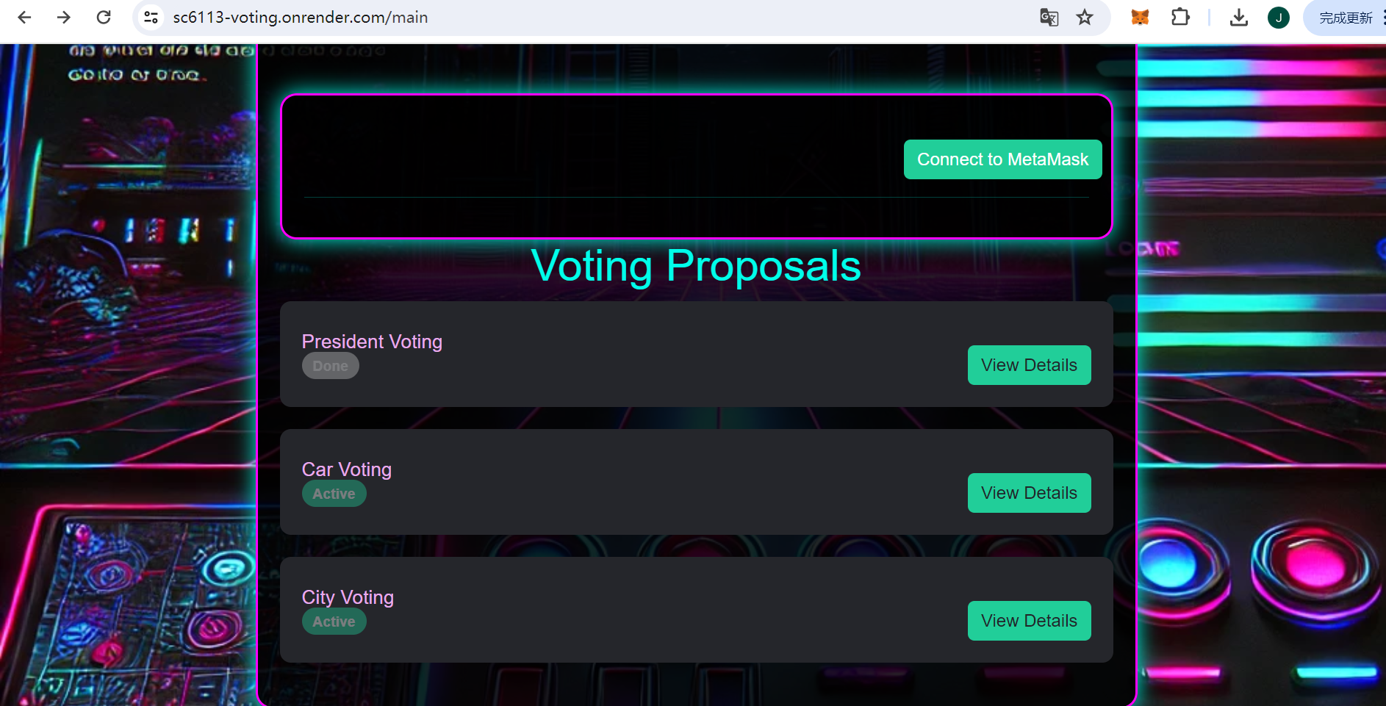
Home page
NO.1

Slide 11
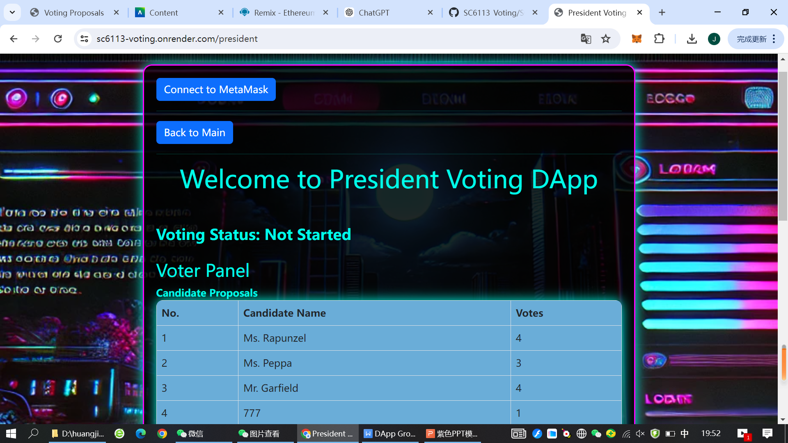
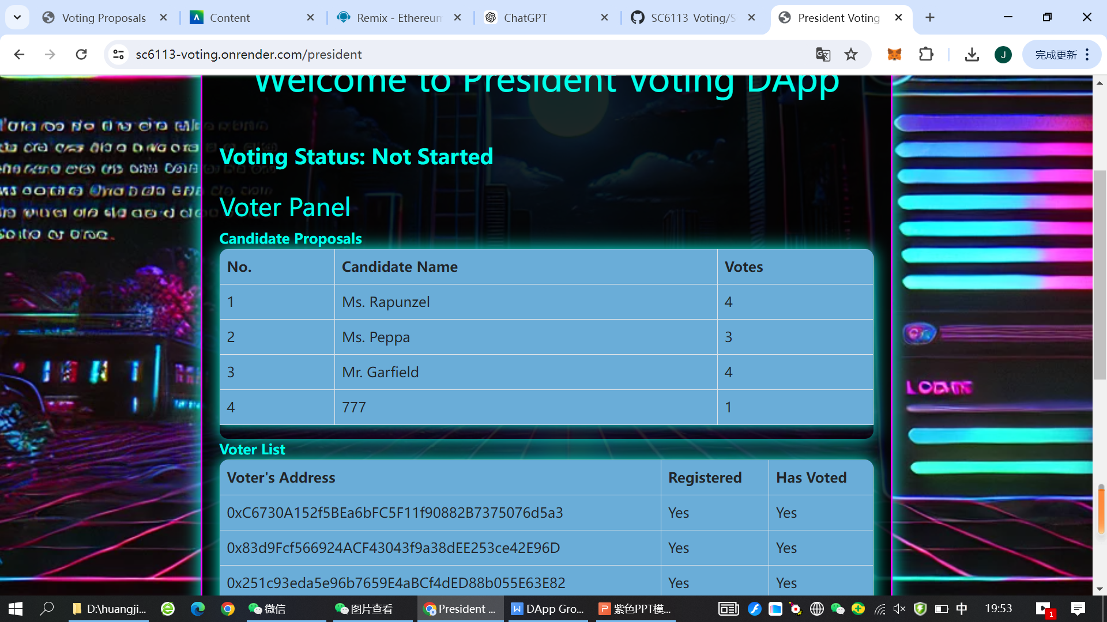
Index page
NO.1

Slide 12
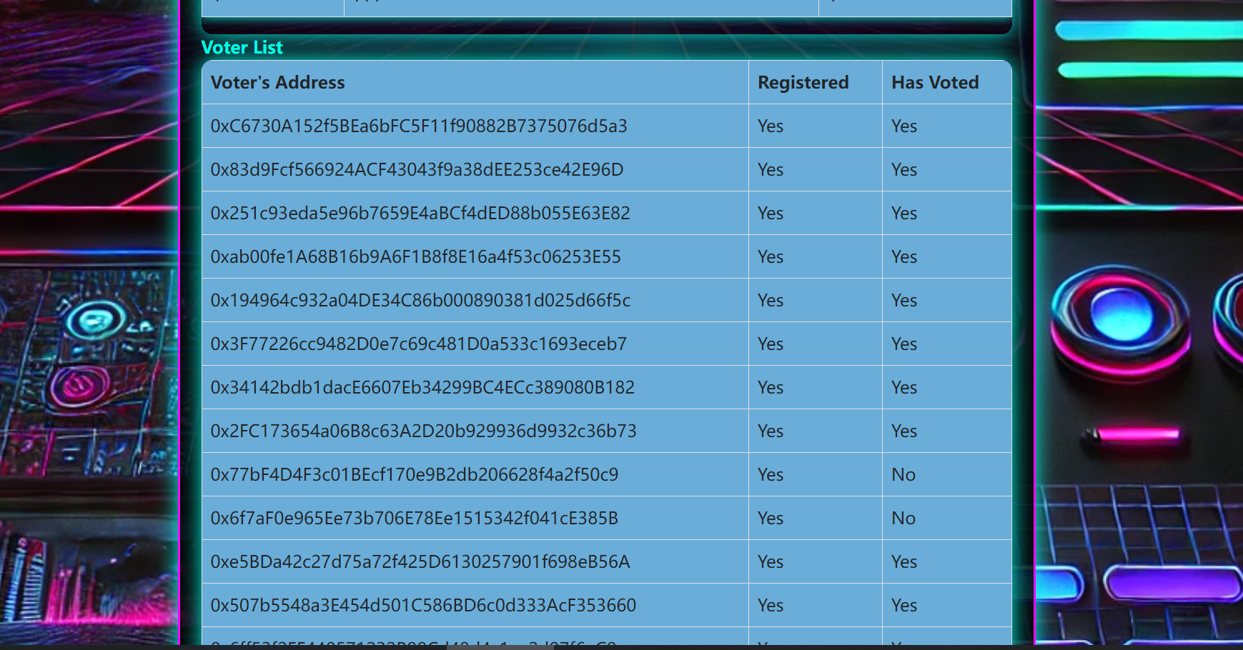
Index page

Slide 13
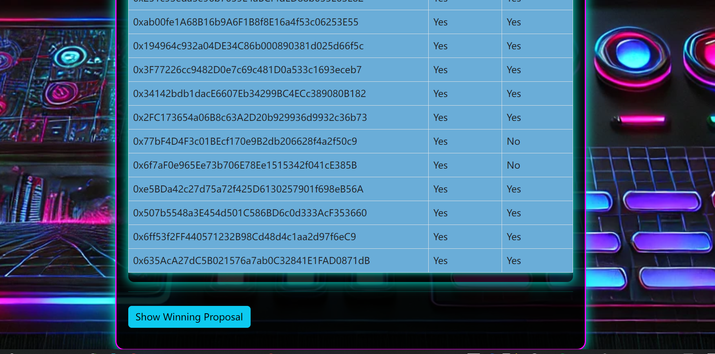
Index page

Slide 14
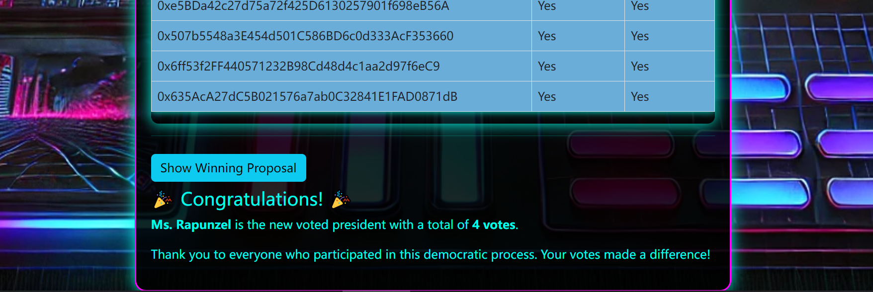
Testing Result

